Slide 1
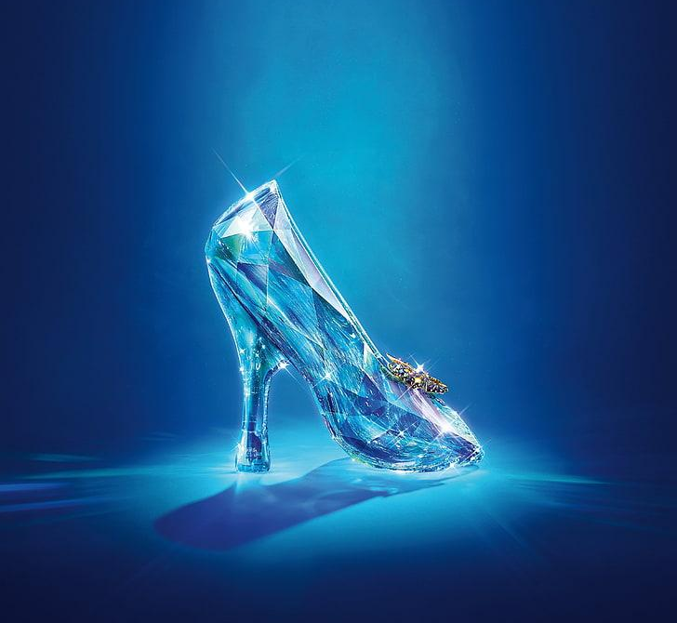

Predicting If The Shoe Fits
By: Noah Berger, Kaylee Cheu, Juliana Dees, and Nate Garlati
We created a model to predict “Cinderella teams” in March Madness.
Moneyball Academy 2022
Notes:
nate

Slide 2
Once Upon a time…
Part 1
Stating our goal and Data Collection
Notes:
kaylee

Slide 3
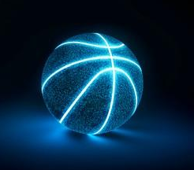

Goal
We wanted to see if we could create a model to predict Cinderella teams in March Madness using regular season data.
Notes:
kaylee

Slide 4
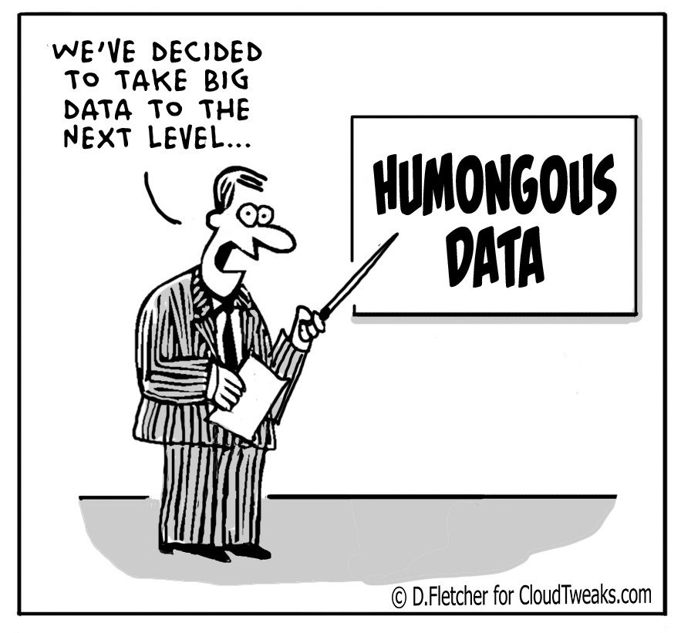
Collecting Data
We collected our data from Sports Reference (regular season stats), Bracket Odds (predicted wins by seed), and Data World (March Madness results). We then combined these multiple data sets to create one new data set, ncaa_joint, so we could easily manipulate it to fit our needs.
Notes:
juliana

Slide 5
Defining the Glass Slipper
Part 2
What makes a team a Cinderella?
Notes:
nate

Slide 6
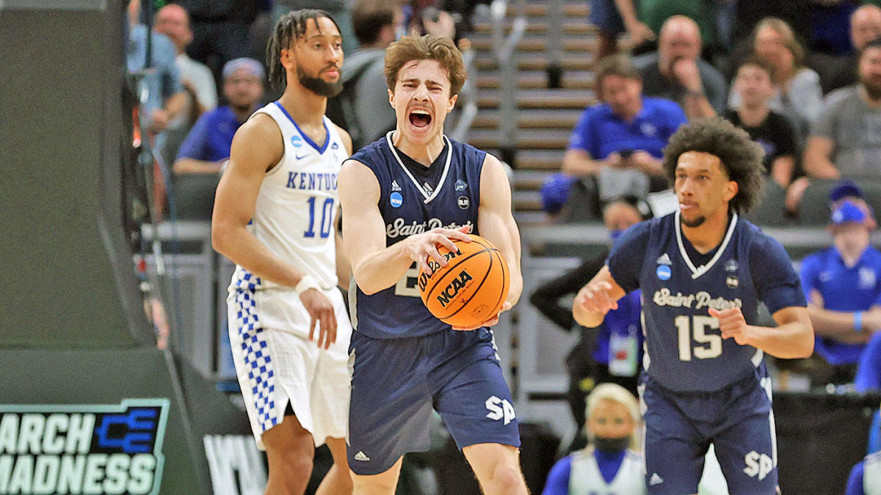
A ‘cinderella team’ is defined by the NCAA as:
A team that is the 11th seed or worse
Wins at least 2 games in March Madness* (makes it to the sweet sixteen round)
*Does not include wild card games
Notes:
nate

Slide 7

- Binomial = hard to model
- Continuous score
- Cinderella team = one that won more games than expected
Notes:
(Noah)The Problem with using the NCAA definition of a cinderella team is that it’s binomial - a team is either a cinderella or it isn’t. This makes it very hard to create a model. It would be better if we could create a continuous score that represents how much of a cinderella a team is. We want a cinderella to be a team that won more games than expected, but we don’t want to have 1 seeds that win the championship to show up.

Slide 8
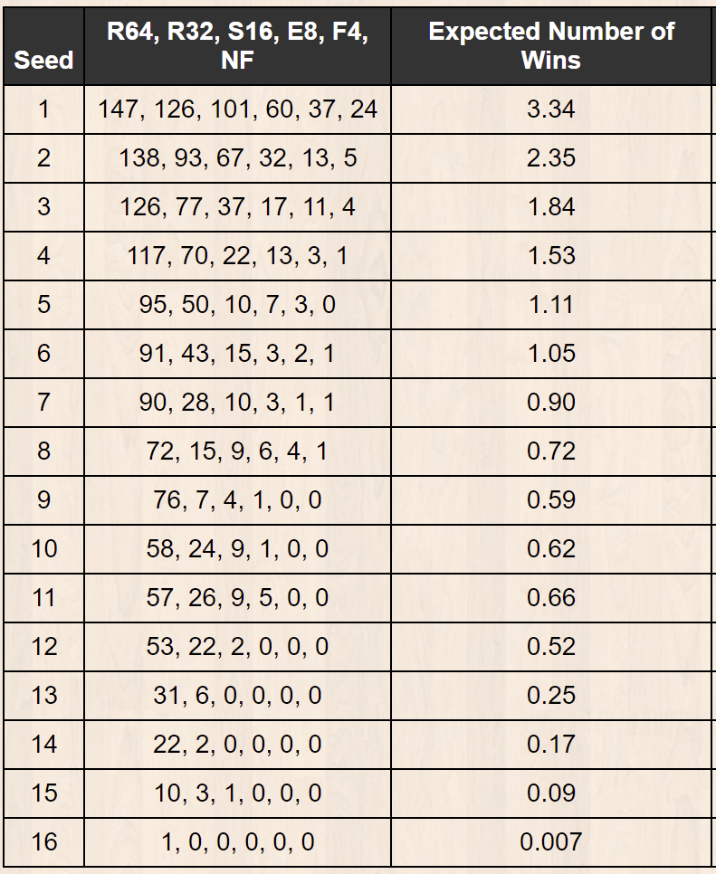
THE SOLUTION
1. Find the predicted number of wins for each seed
2. Find the actual amount of games won by each team
3. Divide actual games won in March Madness by predicted number of wins
4. Call this new number the “Cinderella Score”
5. Final Formula: cind_score = mm_games_won/seed_predicted_wins
Notes:
juliana

Slide 9
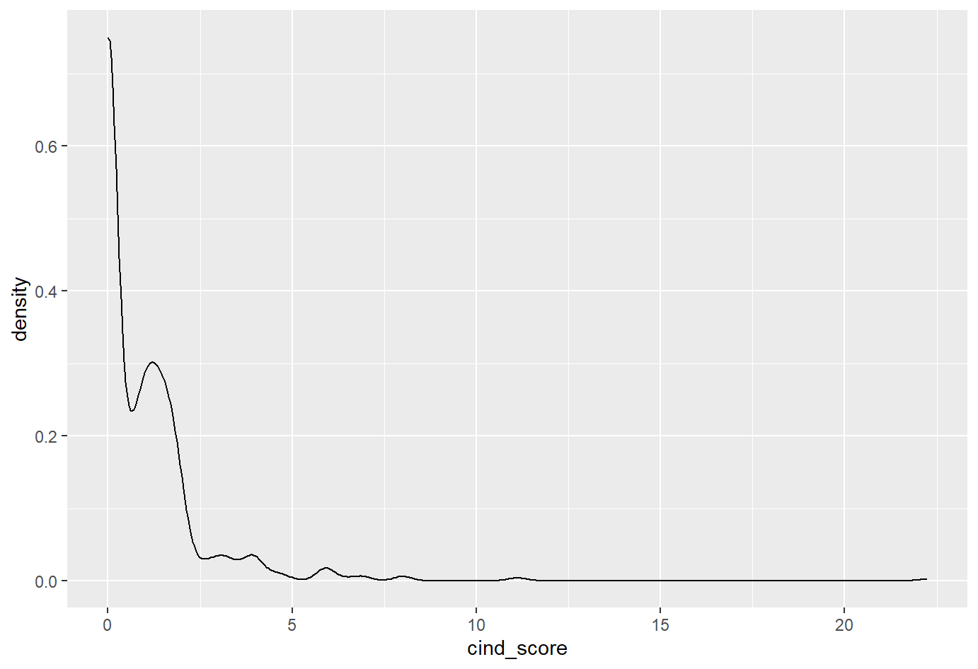
Density Curve of Cinderella Scores
Mean = 0.982
Median = 0.453
SD = 1.58
Lehigh 2012,
Norfolk State 2012
Florida Gulf Coast 2013
Notes:
noah

Slide 10
Gifts from our fairy godmother
Part 3
This is a metaphor where our fairy godmother represents R and the gifts are analogous to variables that correlate to cinderella teams.
Notes:
Kaylee

Slide 11
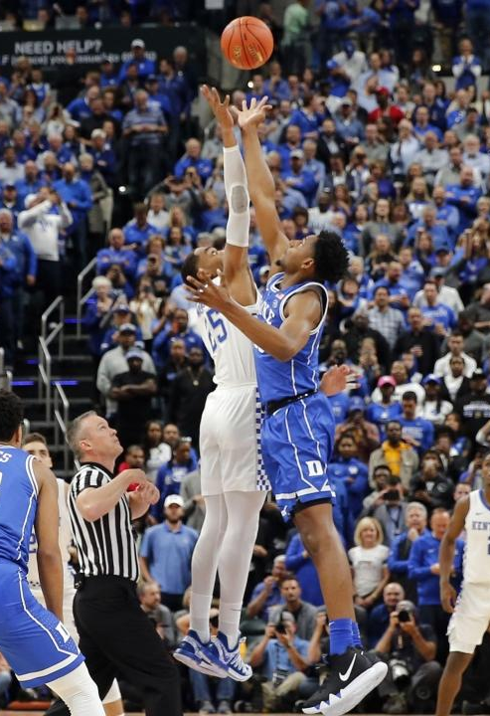
Creating a new non-pythag formula
For NCAA Basketball
Notes:
nate

Slide 12
pythag_general = (points_for-points_against)/(points_for+points_against)
pythag_predicted_wins =
18.68 + 97.28(pythag_general)
Pythag_resid =
(pythag_predicted_wins)-(total_wins)
General formula
New non-pythag formula for NCAA basketball
Formula for pythag residual
Notes:
[noah]
1. General formula
- Professor Wyner taught us in class
2. Prediction
- Ran a regression to predict the number of wins
3. Error
-
Created a regression model with x as pythag and y as to total wins and then found our best fit line
Negative = team lucky

Slide 13
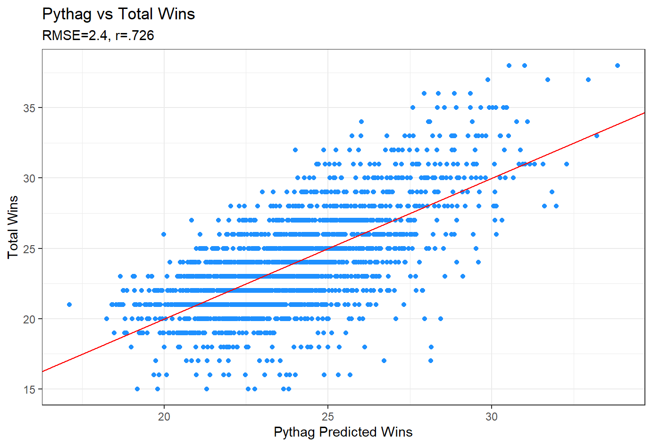
A chart representing the correlation of a team’s expected wins using the Pythag formula, and their actual win total.
Notes:
juliana

Slide 14
Other useful Variables
SOS = Strength of Schedule
SRS = Simple Rating System
TPP = Three Point Percentage
FGP = Field Goal Percentage
Notes:
Kaylee

Slide 15
The Clock Strikes 12
Part 4
Our final model
Notes:
kaylee

Slide 16
Our Final Model
Phat_cind_score =
0.686543 + pythag_predicted_wins*0.238709 +
pythag_resid*0.393451 + WLP*-7.422530 +
seed_predicted_wins*-1.025192 + SOS*0.00863 +
SRS*0.102137 + TPP*0.951688 + FGP*-1.94901
Notes:
noah

Slide 17
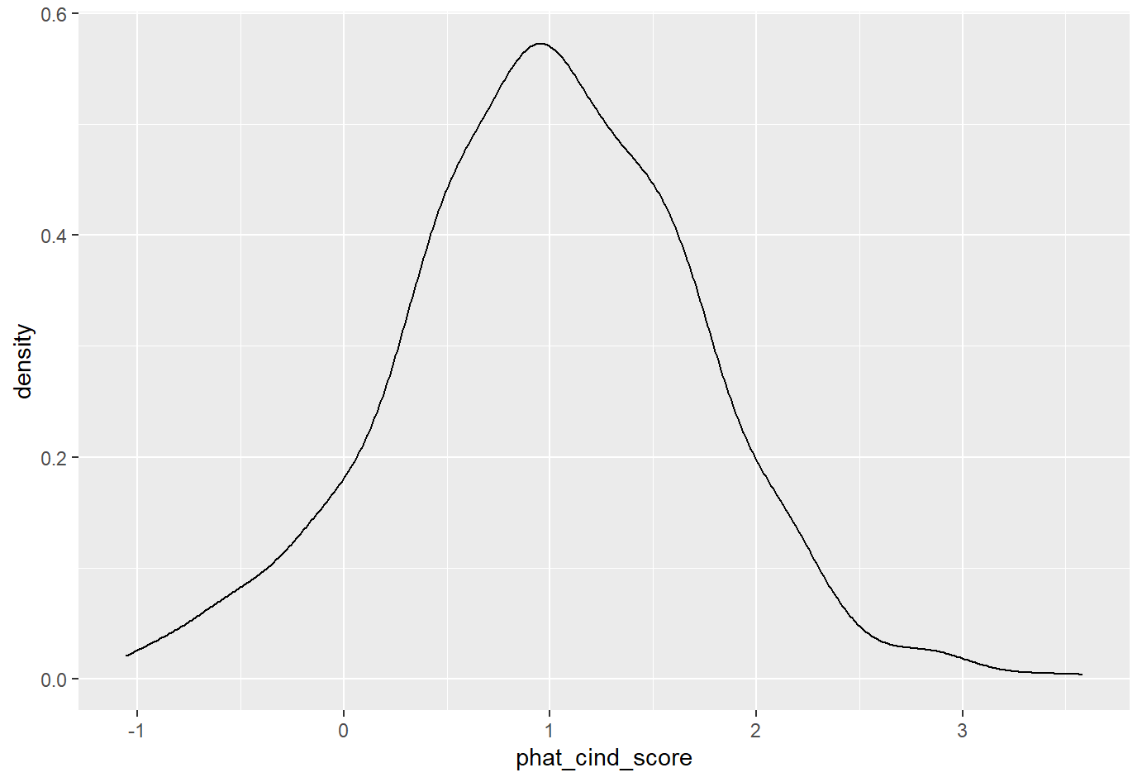
Density Curve of Predicted Cinderella Scores
Mean = 0.986
Median = 0.989
SD = 0.724
Notes:
noah
Normal curve - mean and median same (expect most of data ~66% to be between .25 and .75 range - -1 to 4

Slide 18
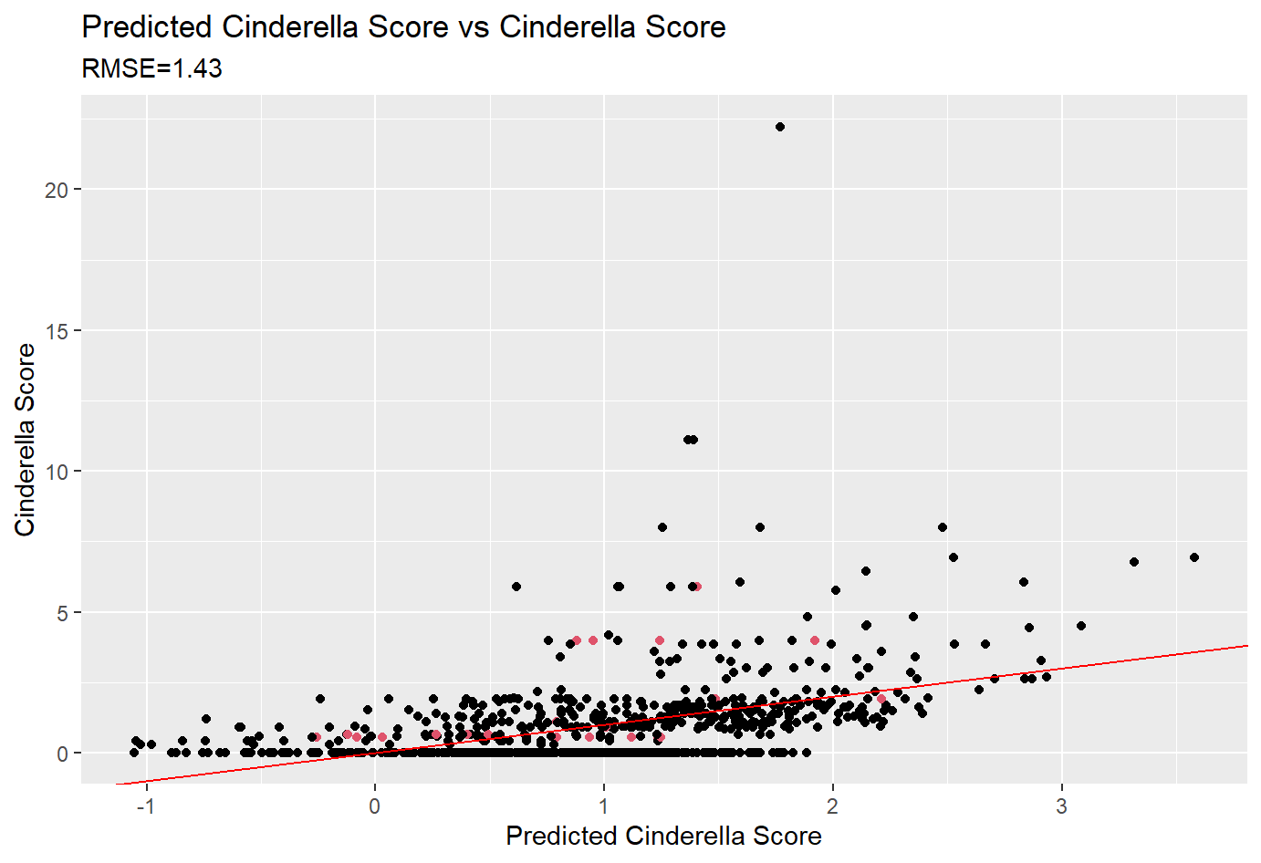
*Red Dots are teams that fit the official definition of a cinderella team
Notes:
noah

Slide 19
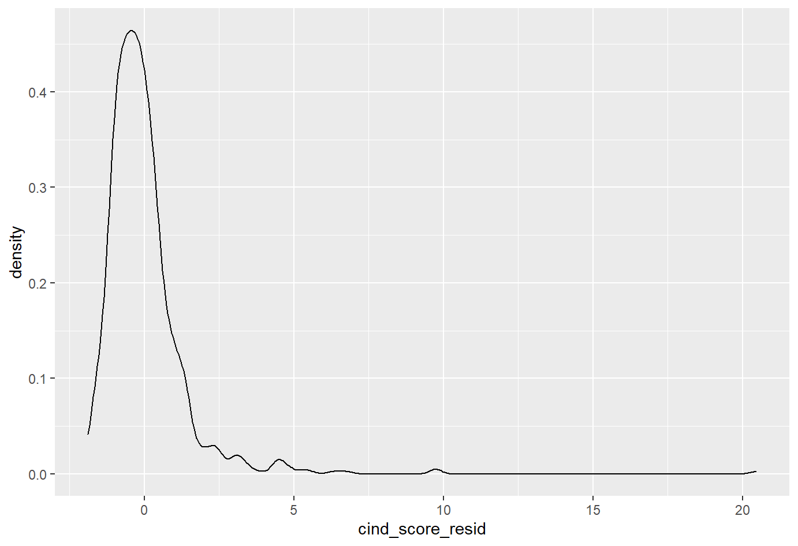
Density Curve of (Predicted Cinderella Score) - (Actual Cinderella Score)
Notes:
kaylee

Slide 20
Happily Ever After
Part 5
Final Conclusions
Notes:
Kaylee

Slide 21


A couple of outliers
St. Peter’s 2022 has a predicted cinderella score of .837
They had an actual cinderella score of 33.33
UMBC 2018 has a predicted cinderella score of 1.25
They had an actual cinderella score of 142.86
Notes:
nate

Slide 22
Conclusions
extreme outliers, particularly in lower seeded teams
extremely random and unpredictable
Exponential formula?
Rare events will take place over many trials
Notes:
juliana

Slide 23
References and Resources
Data from Sports Reference, Bracket Odds, and Data World
Referenced library of past moneyball projects and moneyball project template
Coding help from Stackoverflow and StatisticsGlobe
Pictures from saintpeterspeacocks.com, Wikipedia, Hulu, and eonline.com
Special thanks to Professor Wyner, Naomi, Justin, Elan, Jake and all the other TAs!
Notes:
kaylee

Slide 24
Thank you!
Questions?
Notes:
kaylee

